Slide 1
MUSIC CLASSIFICATION How does spotify get it right?
Luraschi Matias
Vinci Federico
Bonfanti Ivo
Correa Miguel Eduardo

Slide 2
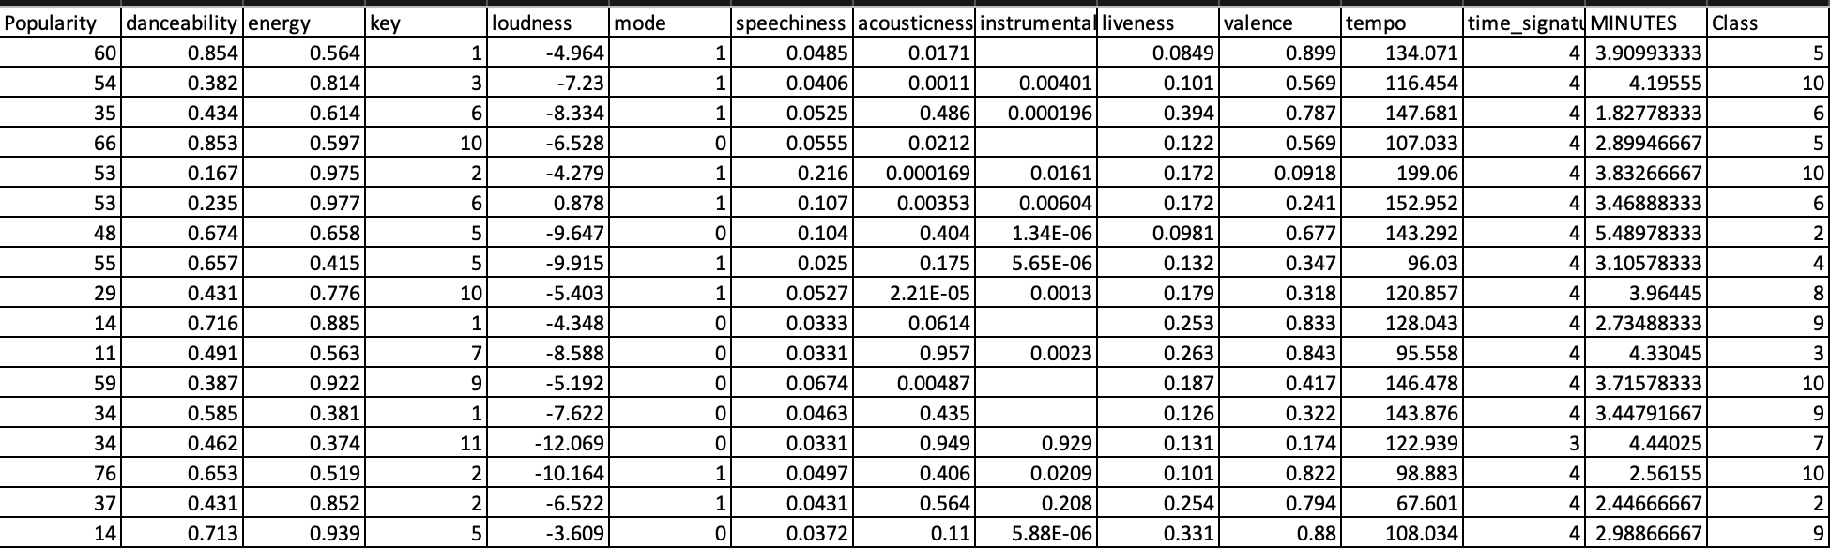
Dataset Description
13 features
1 response variable divided in 11 clases
NA values
Not homogeneos units
Some standarized units
Almost 18.000 observations

Slide 7

First impression?
Features are quite alike between classes. Not the typical texbook example.
Will be quite challenguing to do a proper classification.

Slide 8
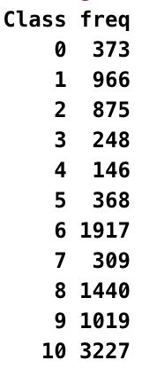

Slide 9
Standard ML techniques such as Decision Tree and Logistic Regression have a bias towards the majority class, and they tend to ignore the minority class. In more technical words, if we have imbalanced data distribution in our dataset then our model becomes more prone to the case when minority class has negligible or very lesser recall.
Solved with SMOTE
SMOTE (synthetic minority oversampling technique). It aims to balance class distribution by randomly increasing minority class examples by replicating them.

Slide 10
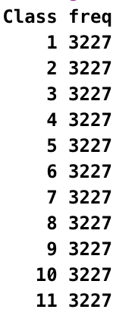

Slide 11
We wanted to reduce the number of features so we started to see if doing PCA was a viable option.
PCA should be used mainly for variables which are strongly correlated. If the relationship is weak between variables, PCA does not work well to reduce data. In general, if most of the correlation coefficients are smaller than 0.3, PCA will not help.
Highest correlation 0.5 then 0.38 and down. Doesn’t seem right to do PCA.
WE TRIED IT ANYWAYS…

Slide 12
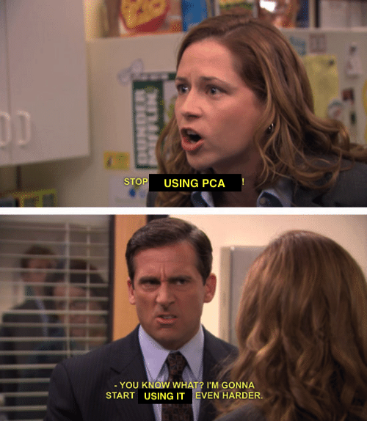

Slide 13
PCA components

Slide 14
PCA shouldn’t be used.
<40%

Slide 15
Classification algorithms
Linear Discriminant Analysis (LDA)
Classification TREE
Support Vector Machine (SVM)

Slide 16
LDA
LDA makes some simplifying assumptions about the data:
Data has Gaussian distribution, meaning that each variable is is shaped like a bell curve when plotted.
That each attribute has the same variance, that values of each variable vary around the mean by the same amount on average.

Slide 17
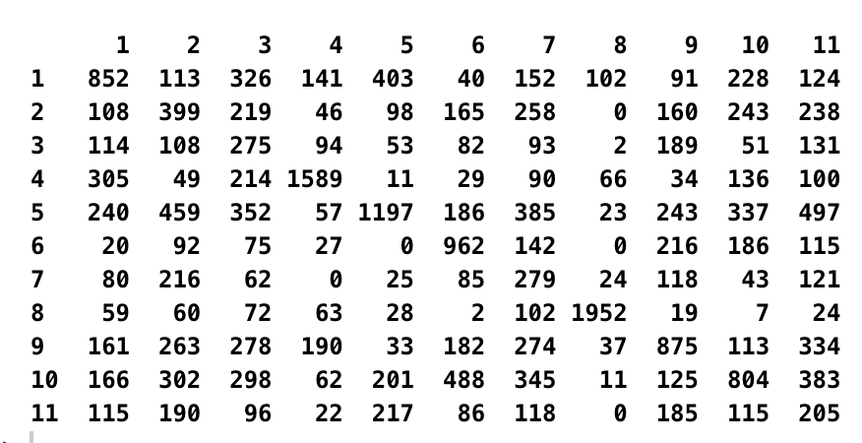
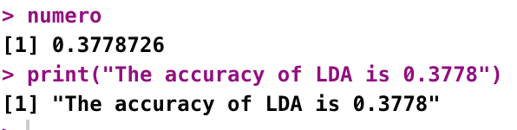
LDA
Confusion Matrix
Accuracy

Slide 18
The more clear groups seem to be Class 4 and Class 8.
While the accuracy of the model is 0.37, the accuracy of each of these two class is 0.49 and 0.60 respectively.
But Class 4 was one of the lowest frequencies (see original distribution)! We oversampled with SMOTE.
Class OVERFITTING?

Slide 19
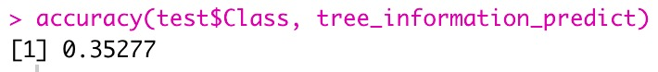
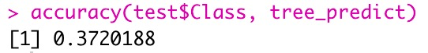
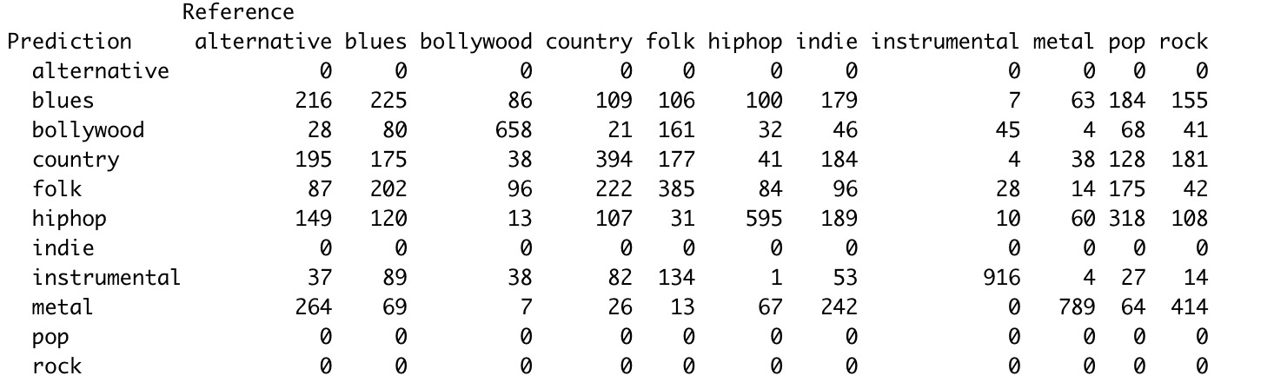
Classification TREE
Tree Information Criteria
GINI Index Tree
CONFUSION MATRIX

Slide 20
Result of the PRUNED TREE
POP, ROCK, INDIE and ALTERNATIVE totally left behind.
What could have gone wrong?
Data was mostly standarized, hence decimal not discrete?
Data too similar?

Slide 21
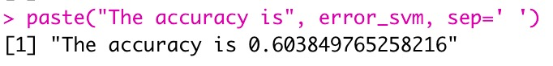
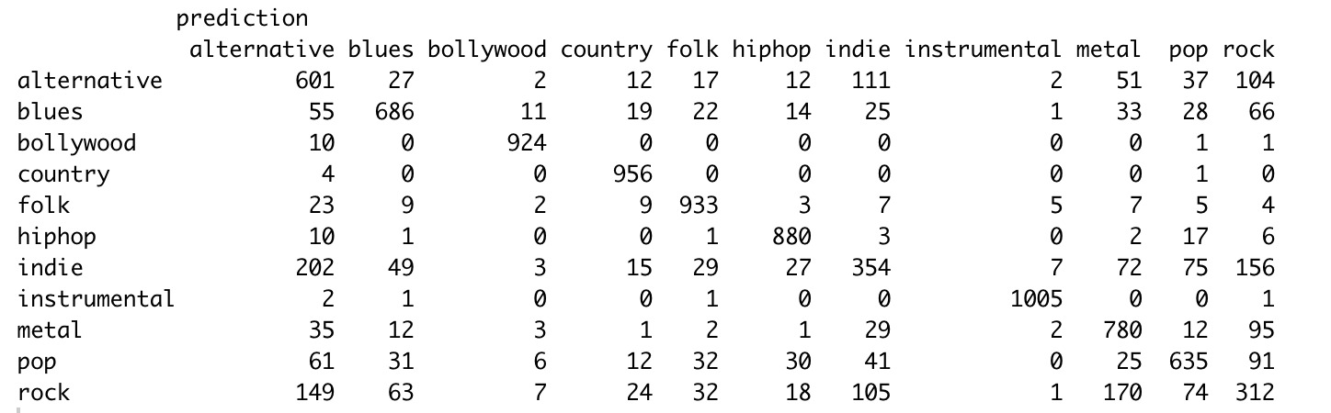
SVM
Accuracy
CONFUSION MATRIX

Slide 22
Business case particularities –final thoughts
Songs might not have only one style, they can be a mix between pop, rock, rap, hip-hop, etc. (e.g. Madonna ft Nicky Minnage, Fedez ft Orietta Berti, etc)
This might affect the way that songs are classified and hence affect the way the algorithm behaves.
We have many alike features and 11 classes.
Data pre-processing is key. Knowing how the algorithm works too.

Slide 23
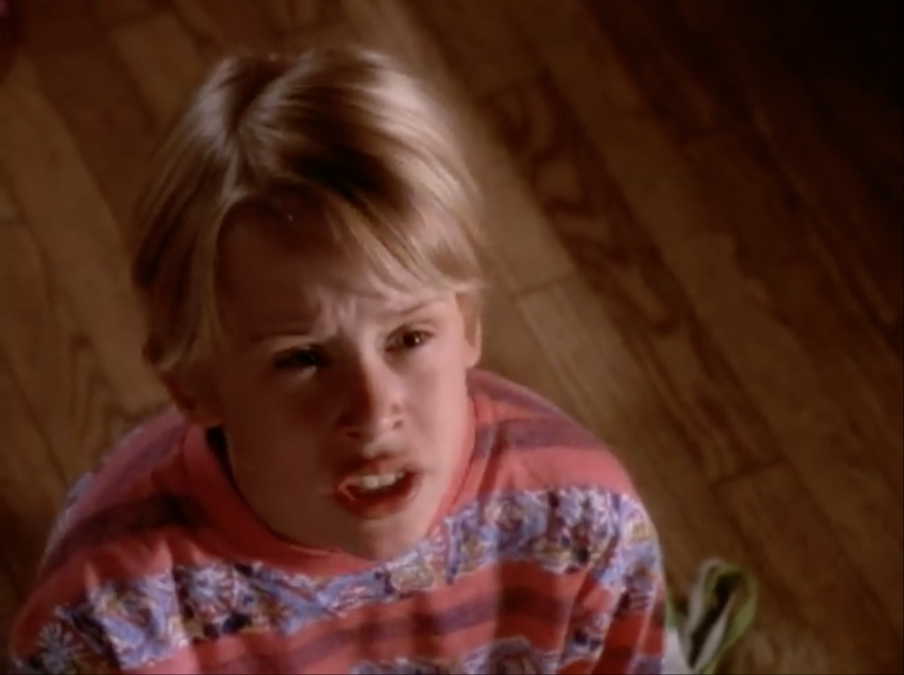



BLACK OR WHITE CASE
Acapella
Pop
Rock
Rap

Slide 24
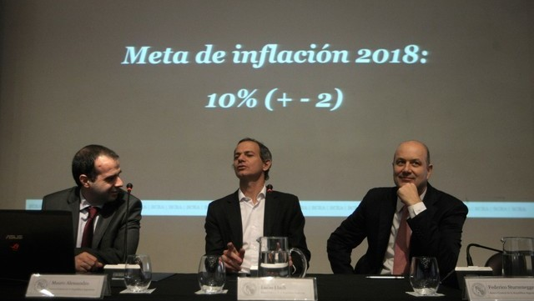
Your model might be fancy and your error might be little…

Slide 25
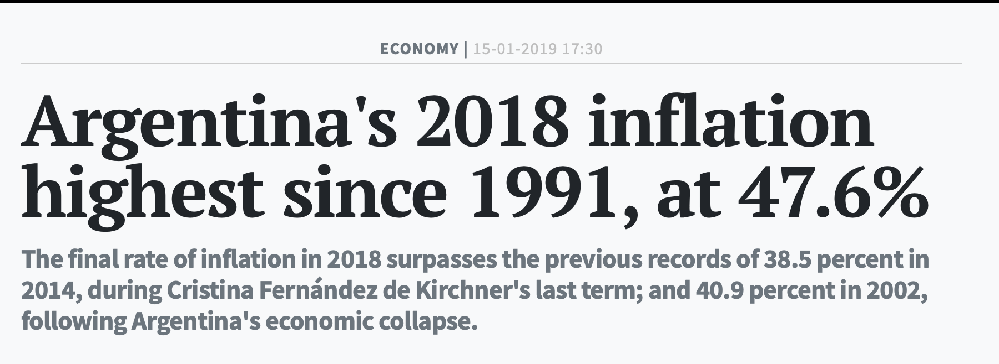
But is it realistic?

Slide 26
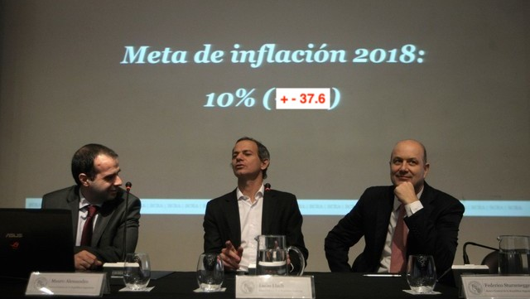
FIXED MODEL

